Slide 1
The Django admin
Notes:
[Mandatory Slide] This would be the introduction slide of the topic that you are covering in this subsection.
When this slide plays, you could talk about the main aim that we’d be covering in this video.

Slide 2
In this Video, we are going to take a look at…
What is the Django admin?
Code sample: setup Django admin and data entry
Notes:
[Mandatory Slide]
Before the start of the video, we’d like to highlight what are important topics or pointers that we’d be covering in this video. This slide would immediately follow the intro/name slide. This would just be say 2-3 points for the viewers to know what they are getting into.

Slide 3
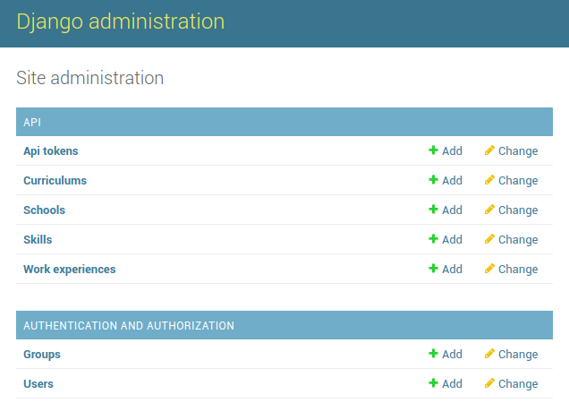
What is the Django Admin?
The Django Admin is web-based GUI that Django automatically generates from the models of all installed Django apps.
It is conceived as a management tool to be used by the maintainers of Django applications (eg. for data entry/reconciliation)
The Django Admin is enabled by default on Django apps but you need to wire your app’s models to the Admin app inside the admin.py file:
create a ModelAdmin subclass for each model
register them to the admin app
from django.contrib import admin from cv.api.models import School class SchoolAdmin(admin.ModelAdmin): pass
admin.site.register(School, SchoolAdmin)
Notes:
[Mandatory Slide]
Before the start of the video, we’d like to highlight what are important topics or pointers that we’d be covering in this video. This slide would immediately follow the intro/name slide. This would just be say 2-3 points for the viewers to know what they are getting into.

Slide 4
Code Sample: setup Django admin and data entry
Notes:
Something that needs to grab the viewers attention!!

Slide 5
Summary
What is the Django admin?
Code sample: setup Django admin and data entry
Notes:
[Mandatory Slide]
Before the start of the video, we’d like to highlight what are important topics or pointers that we’d be covering in this video. This slide would immediately follow the intro/name slide. This would just be say 2-3 points for the viewers to know what they are getting into.

Slide 6
Coding the Django views and setting URL routes
Next Video
Notes:
[Mandatory Slide]
Here the name of the next video needs to be mentioned. The narration as you guessed it would be just letting the viewer know exactly where we are at and what we’d be taking over next! ☺

